Slide 1
Ubisecure APIs
Integration points with other systems

Slide 2
Agenda
This module introduces the main API interfaces that external applications can use when integrating with Ubisecure IAM products.
OAuth 2.0 API
Directory User Mapping
Ubisecure OTP List Server
Ubisecure SSO Discovery API
Ubisecure SSO Template API
CustomerID Integrations
REST API
Registration Backend Queries
SSO Management API

Slide 3
Ubisecure SSO – OAuth 2.0 Authorization Server
Ubisecure SSO implements the OAuth 2.0 authorization server role.
The main use cases are
authorization code grant and web single sign-on
authorization code grant and native applications
password grant and native applications
password grant and server-to-server integrations

Slide 4
Ubisecure SSO – OAuth 2.0 Authorization Server Standards and recommendations reference
The OAuth 2.0 Authorization Framework
https://tools.ietf.org/html/rfc6749
https://tools.ietf.org/html/rfc6750
OpenID Connect Core
http://openid.net/specs/openid-connect-core-1_0.html
OAuth 2.0 Token Introspection
https://tools.ietf.org/html/draft-ietf-oauth-introspection-08

Slide 5
OAuth Metadata and Endpoints
Found at URL
https://mno.ubidemo.com/uas/oauth2/metadata.json

Slide 6
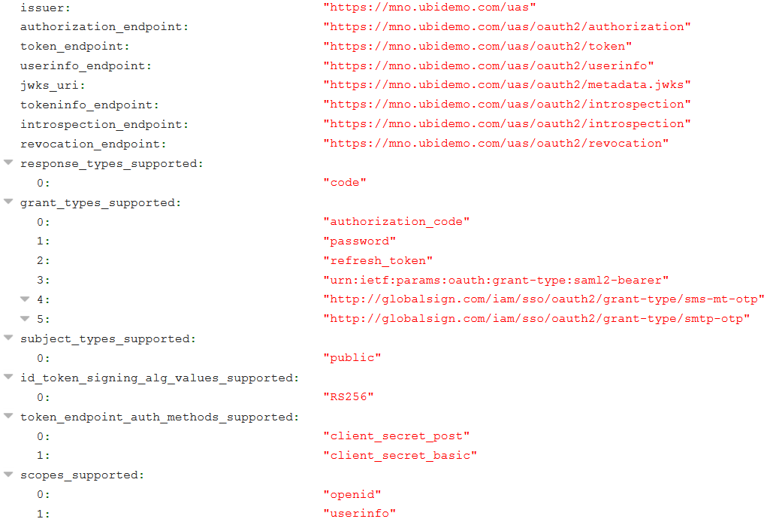
Typical endpoints from metadata.json

Slide 8
OAuth2 request parameters
Required parameters
response_type = code
For authorization code grant the value must be set to “code”
scope = userinfo
For web single sign-on use case the value is set to “userinfo“
client_id
OAuth Client Identifier of the web application
redirect_uri
The redirect uri value must have been be registered with SSO management
Sample authorization request
GET https://sso.example.com/uas/oauth2/authorization?response_type=code&scope=userinfo&client_id=2001221477&redirect_uri=https://client.example.com/response&state=40e1bfc0-4587-4859-be08-a58e3fffa37a

Slide 9
Protecting an API
Ubisecure SSO:
Authorization Server
1. Present Credentials
Get OAuth Token
3. Validate OAuth Token
Mobile Application
2. Present
OAuth Token
Portal
Client
Resource Server
User

Slide 10
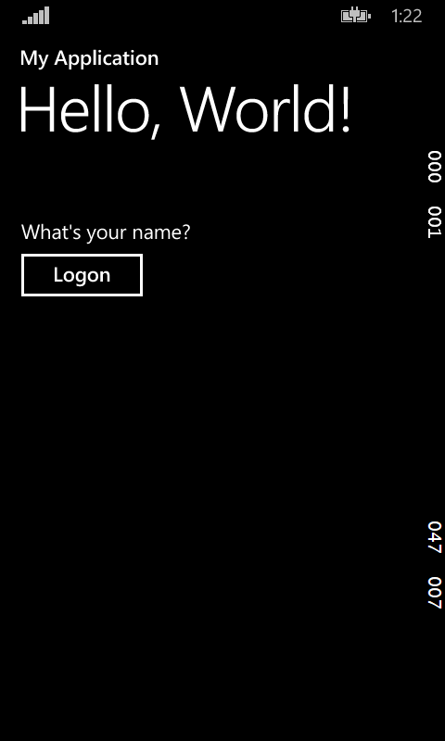
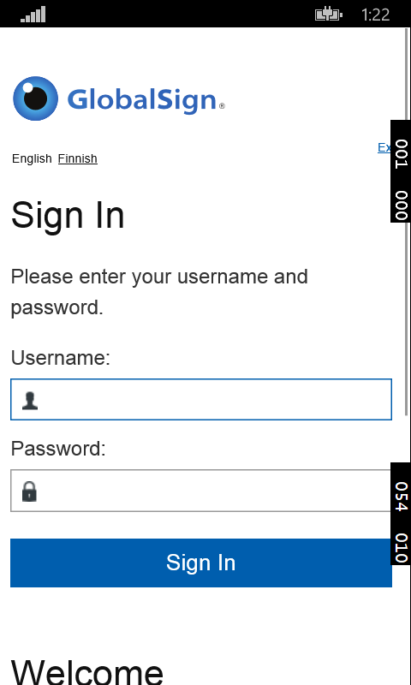
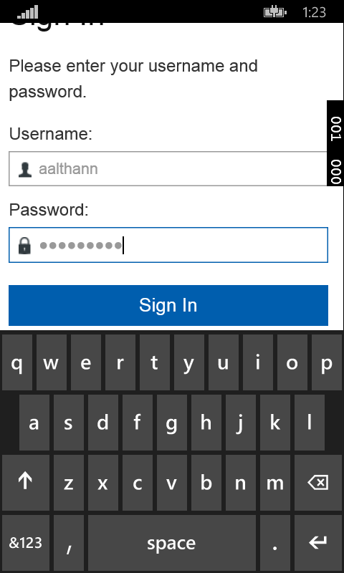
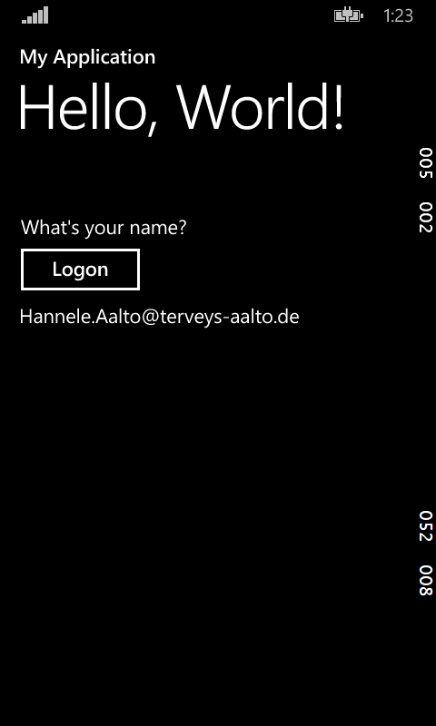
Mobile App Example

Slide 11
Directory User Mapping

Slide 12
REST Attribute Query for Directory User Mapping
Enables mapping of external identities to local directory users
A query to an external REST service is executed during each login
Customer or integrator provided REST service accepts an ID from Ubisecure SSO and returns a matching value
This returned matching value is used for directory user mapping
REST service can be coded to implement other application requirements (e.g. On the fly provisioning)
Example – map social security number received from bank to AD account name using data from HR database. Removes the need to store or synchronise SSN in AD

Slide 13
Ubisecure REST Service Login Query Use Case: User Matching based on external data
Social Security Number
Identity Provider
Social Security Number
REST
Authenti-
cation
samAccountName
Lookup
Database
AD
User matched based on samAccountName.
No SSN required to be stored in user directory.

Slide 14
Ubisecure REST Service Login Query Use Case: On-the-fly provisioning
userid
Identity Provider
userid
REST
Authenti-
cation
userid
login request
Check user exists, provision if required
User Directory
User provisioned to User directory

Slide 15
REST Attribute Query for Directory User Mapping
Ubisecure SSO Configuration
ubiloginConfString: xmlns ns http://schemas.datacontract.org/2004/07/RestfulDataService ubiloginServiceOutputParameter: directory.login //ns:Person/ns:WebId ubiloginServiceTemplate: http://lookupservice/GetUsername?ssn=${param1}
Request
http://lookupservice/GetUsername?ssn=010180-1234
Response
<Person xmlns="http://schemas.datacontract.org/2004/07/RestfulDataService" xmlns:i="http://www.w3.org/2001/XMLSchema-instance"> <WebId>john.smith</WebId> </Person>

Slide 16
Ubisecure OTP List Server Overview
API enables third-party implementations of
Administrative list management
OTP Printout list distribution through non-online channels
Pre-printed credit card lists
Secure mailing
completely customized user interface implementation
Supported operations
Create OTP list
Associate OTP list with user identifier
Query OTP list status by list id or user identifier
Delete OTP list

Slide 17
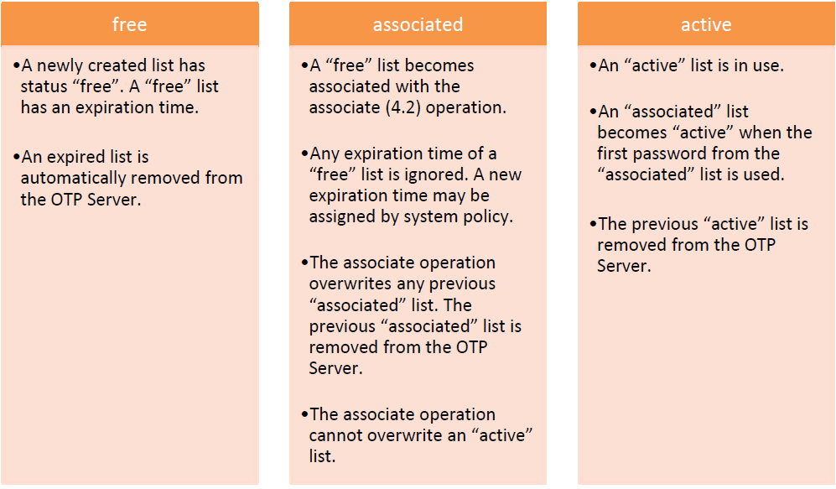
Ubisecure OTP List Server List status

Slide 18
OTP List Server API example
Example of otp-list
POST /otp.1/otp-list?expires=20130101
<otp-list id=”f000d9d5-d97d-4347-b4ff-e2edb72b35fd” expires=”20130101” size=”50”>
<sequence>
<otp index=”1”>123456</otp>
<otp index=”2”>234567</otp>
...
</sequence>
</otp-list>
Example of list association
PUT /otp.1/otp-list/f000d9d5-d97d-4347-b4ff-e2edb72b35fd?uniqueID=user1
<otp-list id=”f000d9d5-d97d-4347-b4ff-e2edb72b35fd”>
<status value=”associated” index=”1”>
<user-info uniqueID=”user1”/>
</status>
</otp-list>

Slide 19
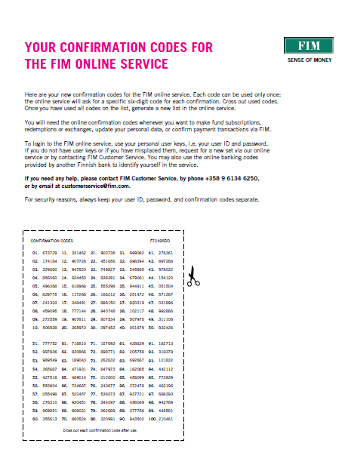
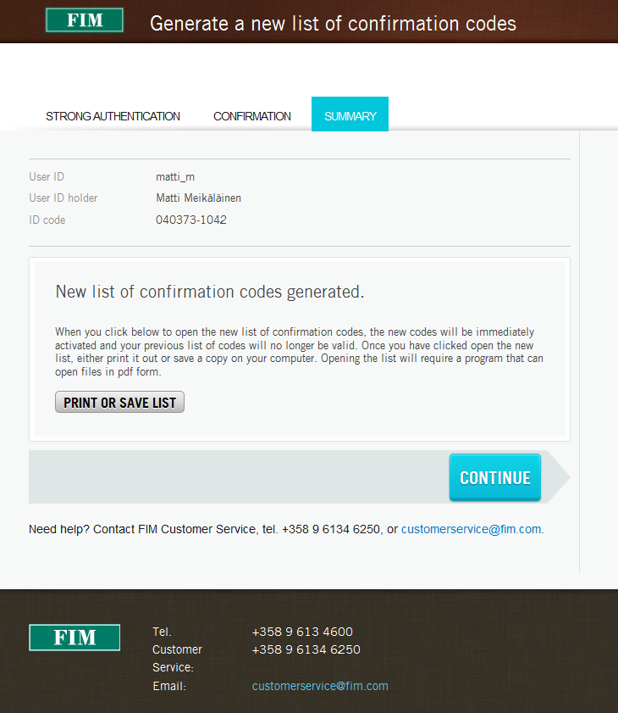
Example implementation
Use case: Custom printing process (end-user PDF download)

Slide 20
Use case: Pre-print OTP lists and distribute on an as-needed basis
Print and give to customers by hand at point-of-service
Print in printing facility and send with customer mailouts (first bill, welcome letter etc)
Keep at office reception for rapid linking
Implemented processes must take in account security aspects (sealed security envelope, tamper proof scratch film etc)

Slide 21
Discovery and Template UI API

Slide 22
Ubisecure Discovery UI API Overview
API enables third-party implementations of
authentication method selection user interfaces
dynamic handling of identity provider selection
JSON formatted real-time feed
Currently trusted identity providers
Currently support user interface languages and language descriptions
Example
Mobile application selection
Javascript method selection implemetation in SP application
Future devices (Voice, gesture, location etc)
Format
https://UAS_URL/uas/discovery?entityID=urn:uuid:8512397f-8c81-38cb-b500d1c9b657b1f5 &template=default&locale=en

Slide 23
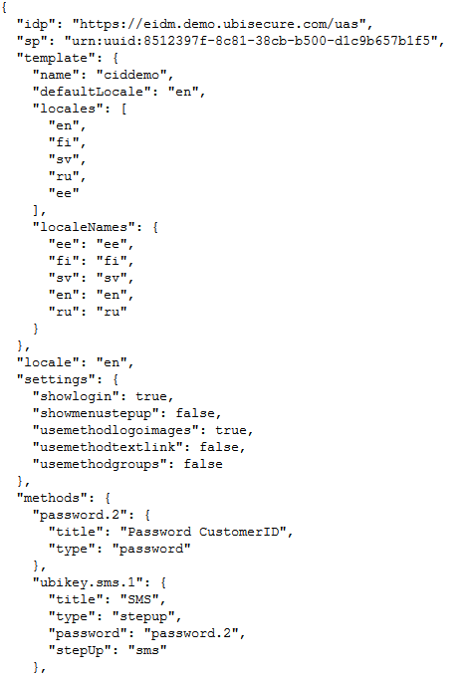
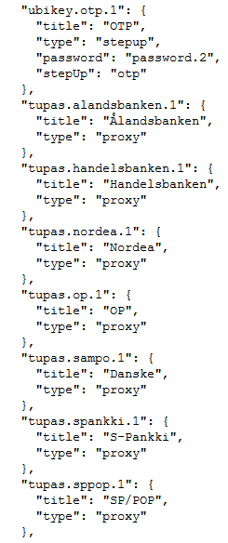
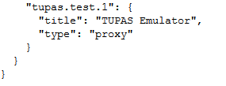

Slide 24
Ubisecure SSO Template APIs
Template API allows for a consistent and safe reference method to elements required for providing custom user experiences
Examples
Dynamically showing currently supported authentication methods within an third-party application
Benefits
Reducing redirections
Faster user experience
Consistent API across future product releases

Slide 25
Ubisecure SSO Template APIs
CSS
Returns the CSS stylesheet file defined in the css property of the requested template.
/uas/template/<template>/style.css
Logo
Returns the logo defined in the requested template. The preferred locale may be defined in URL parameter locale. SVG, PNG, ICO formats
/uas/template/<template>/logo?locale=<locale>
Method images
Returns the image defined for the method specified in <method> in the requested template.
/uas/template/<template>/method-image/<method>

Slide 26

Example
https://sso.example.com/uas/template/default/method-image/openid.facebook.1

Slide 27
Ubisecure SSO Template APIs
Resources in resource.index file
Returns a resource defined in resource.index file.
/uas/template/<template>/resource/<resource-name>?locale=<locale>
Template-JSON
Returns the JSON–representation of the requested template. If the URL parameter callback is defined, the returned JSON–object will be wrapped inside the function call defined in <jsonp>.
/uas/template/<template>/json?locale=<locale>&callback=<jsonp>
Example
https://sso.example.com/uas/template/template/json?locale=en&callback=helloworld helloworld({"template":{"name":"template","defaultLocale":"en","locales":["en","fi","sv","ru","jp"],"localeNames":{"fi":"fi","jp":"jp","sv":"sv","en":"en","ru":"ru"}},"locale":"en"});

Slide 28
Examples
https://eidm.demo.ubisecure.com/uas/template/ciddemo/json?locale=fi&callback=callback
https://eidm.demo.ubisecure.com/uas/template/ciddemo/logo.png?locale=fi
https://eidm.demo.ubisecure.com/uas/template/ciddemo/method-image/tupas.nordea.1

Slide 29
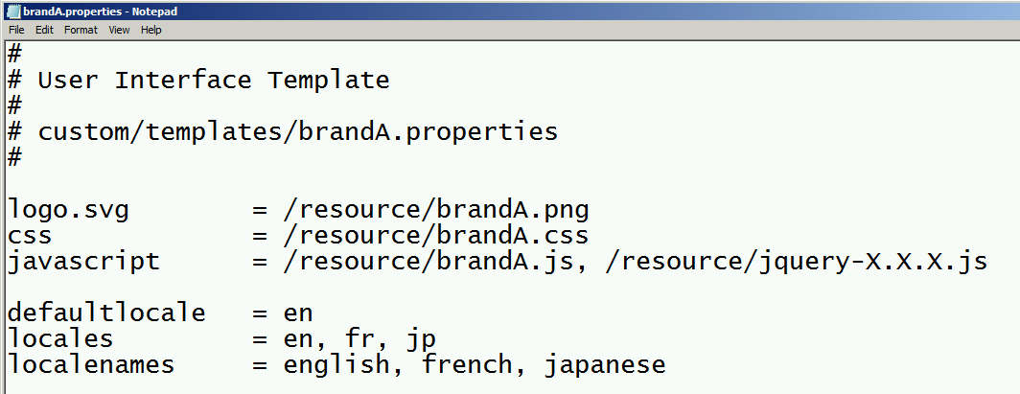
SSO UI and JavaScript

Slide 30

SSO UI and JavaScript

Slide 31
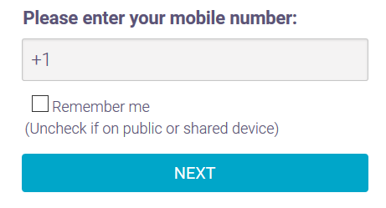
Example – set default values, modify layout

Slide 32
CustomerID REST APIs Registration Backend Queries

Slide 33
CustomerID Integrations REST API
For third-party UI development
For integration with CRM for contract and organization synchronization
Provides Create, Read, Update, Delete operations (”CRUD”)
Organizations
Users
Roles
Mandates
Credentials
Detailed examples and responses given in API document

Slide 34
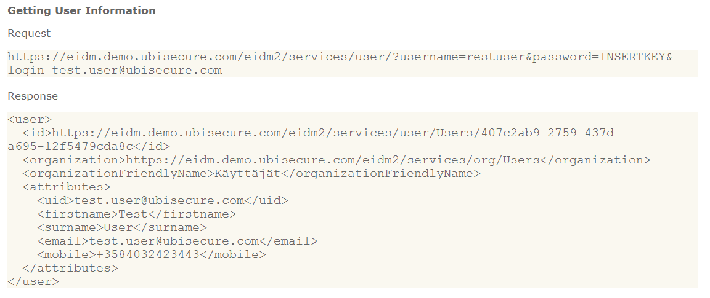
CustomerID Integrations REST API - List User

Slide 35
Modification and Request API Commands (Version 2.1)
Modification Operations
POST100 Create Organization
PUT101 Update Organization
DEL102 Delete User
PUT103 Update User
Request Operations
GET104 List Users
GET113 List Organization's Users
GET105 Query User
GET106 List Organizations
GET107 Query Organization
GET108 List Roles
GET117 List User's Roles
GET109 Query Role
GET110 List Mandates
GET118 List Organization's Given Mandates
GET119 List Organization's Received Mandates
GET120 List User's Given Mandates
GET121 List User's Received Mandates
GET122 List User's Received Mandate Delegations
GET111 Query Mandate
GET112 List Role Invitations
GET114 List Role Invitations (for user)
GET115 List Received Mandate Role Delegations (user)
GET116 Query Mandate Role Delegation

Slide 36
CustomerID Integrations Registration Backend Query
Allows enrichment of user information from 3rd party system
Request may include information that users have given and other parameters such as language code.
Backend can be used as a part of all workflows to check validity of the information that user has given and for requesting more information about the user.
Response may include a status code, error message and information about the user. Backend configuration supports backends based on REST web services.
The responses must be in valid XML-format.

Slide 37
CustomerID Integrations Backend REST request configuration
Input describes the parameters that the backend gets in a request during the registration. For example,
customerdata.input = { "email": "Email", "accountnumber": "AccountNumber" }
Output describes the parameters that the backend sends back in a response. For example,
customerdata.output = { "/customer/lastname": "surname", "contract": "contractnumber" }

Slide 38
Backend configuration
Defaultparameters-parameter describes the list of static parameters that are sent to the backend in every request. (JSON object notation)
Langcode-parameter describes the parameter which is the name of the language code parameter in request.
customerdata.config = { "url": "http://localhost:7080/backend", "timeout": "3000", "defaultparameters": { "authcode": "123" }, "langcode": "locale", "statuscode": "/customer/status", "statusmapping": { "OK": "OK", "NOT_OK": "ERROR", "CRITICAL": "STOP" }, "message": "/customer/error" }
Statuscode-parameter describes where the status code is in response (XPath expression syntax).
Statusmapping-parameter describes the status code value in response and result action in CustomerID.
Message-parameter describes where the error message is in response (XPath expression syntax).

Slide 39
Backend REST requests
Backend related parameters in eidm2.properties
registration.X.userinfo.fields = {email, accountnumber}, {surname, …} registration.X.userinfo.backend = 1:customerdata
Example of a backend request and a response
Request (HTTP GET):
http://localhost:7080/backend?Email=user@test.com&AccountNumber=111&authcode=123&locale=fi
Response:
<customer> <firstname>User</firstname> <surname>Test</surname> <contract>123456</contract> <status>OK</status> <error></error> </customer>

Slide 40
CustomerID Integrations Registration Backend Query
XLST transformation of returned XML format is also possible
Makes integration possible where existing REST services exists
The system will add a user to an organization or assign a role or mandate based on response from the trusted third-party web service.

Slide 41
SSO Management API
Automate core configuration tasks

Slide 42
Ubisecure SSO Management API
Ubisecure SSO Management REST API provides REST functionality to manage Ubisecure SSO server similarly as with the management console user interface, and provides the necessary tools to automate Ubisecure SSO Management UI functionality.
The REST API is designed so that it provides the same features as the user interface.
User of the REST API is expected to be familiar with Ubisecure SSO management user interface to fully understand the terms and their meanings.
With Ubisecure SSO Management API, Ubisecure SSO Management console functions can be automated, allowing automation of functions, such as administration and triggered execution of onboarding new Customers and launching Ubisecure SSO instance for brokered e-services delivery for Customer’s

Slide 43
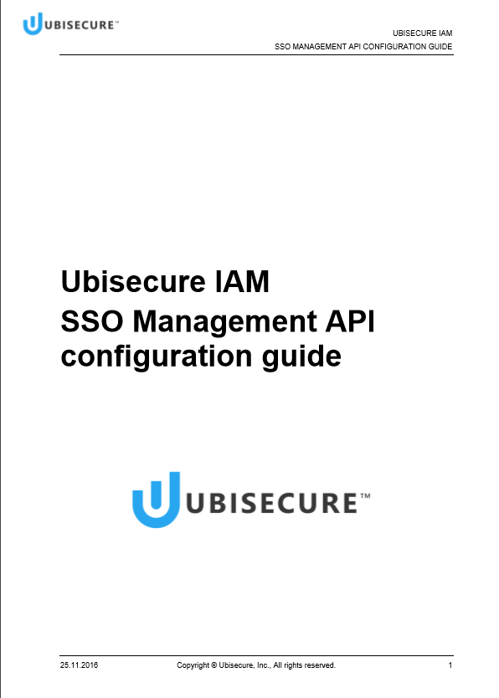
SSO management API
REST API for SSO management
Authentication with OAuth access token
Automate common SSO management tasks
Register and activate applications
Manage access rights and policies
PowerShell module for easy scripting
Works on Windows and Linux

Slide 44
SSO management API – REST example
Create site, application and group
Enable password authentication for application
Allow access to application for group
PUT /site/Sample
PUT /application/Sample/App
PUT /group/Sample/Users
PUT /application/Sample/$link/method/password.1
PUT /application/Sample/$link/allowedTo/group/Sample/Users

Slide 45
SSO management API - PowerShell
Import-Module sso-api
Set-SSOObject “/site/Sample”
$app = Set-SSOObject “/application/Sample/App”
$group = Set-SSOObject “/group/Sample/Users”
$app | Set-SSOLink “/method/password.1”
$app | Set-SSOLink “allowedTo” $group

Slide 46
HTTP Methods
POST writes a new object (Create)
GET is used to query data (Read)
PUT writes object, or overwrites existing data (Create and Update)
DELETE is used to delete data (Delete)

Slide 47
Response messages
Client can choose the result to be plain text, JSON or XML.
This is set on the HTTP accept – header by setting the media type to Accept: text/plain; or Accept: application/json; or Accept: application/xml.

Slide 48
Examples of API calls
Link authentication method to the site
PUT /site/AcmeCorporation/SalesForce/$link/method/password.1
Link a group to the application (allowedTo-attribute)
PUT /application/AcmeCorporation/SalesForce/salesforcesso/$link/allowedTo/group/AcmeCorporation/SalesForce/users
Link a method to the application
PUT /application/AcmeCorporation/SalesForce/salesforcesso/$link/method/password.1
Link an authentication policy to application
PUT /application/AcmeCorporation/SalesForce/salesforcesso/$link/policy/AcmeCorporation/SalesForce/salesforcepolicy
Link a group to customerId group
PUT /group/AcmeCorporation/SalesForce/users/$link/member/eIDM Users/[path to CID group]
Update application metadata
PUT /application/{path to application}/$attribute/metadata
xml or json (form parameter metadata)

Slide 49
Example - SAML2 or OAuth2 integration
Example of creating a SAML2 or OAauth2 application integration to Ubisecure SSO server.
Users of this target application exist in Ubisecure CustomerID and are members of a group that will be linked to this example application.
Example application utilizes the password.1 authentication method.
Example application is created under an existing site named AcmeCorporation.
End result as a tree in the database:
Site: AcmeCorporation
Site: SampleSite
Application: SampleApplication
AllowedTo: SampleGroup
Method: password.1
Authorization policy: SamplePolicy
Policy: SamplePolicy
Group: SampleGroup
Member: link to CustomerID group

Slide 50
Steps to build the application integration
Example OAuth2/SAML2 application is built in following steps using the REST API calls:
Create a site for this application, named SampleSite. Create under the site AcmeCorporation.
Create application, named SampleApplication
Create an authorization policy named SamplePolicy.
Create the group for the application users, SampleGroup
Add the authentication method password.1 to SampleSite to allow using of password based login
Add SampleGroup to SampleApplication’s allowed users
Add the authentication method password.1 also to SampleApplication
Add attributes to SamplePolicy (To define that also email is sent to the caller of this application)
Add SamplePolicy to SampleApplication
Link SampleGroup to correct CustomerID group so that customerID users are linked to SampleGroup.
Add metadata to SampleApplication
After this Ubisecure CustomerID users (of some CustomerID group) have access to SampleApplication

Slide 51
Heavy lifting that Ubisecure SSO Management API takes care of
Registering on behalf of the Customer’s IdP the brokered e-services to be access by the Customer’s users
Exchange of metadata with the brokered e-services to be access by the Customer’s users
Mapping the roles as registered in Ubisecure CustomerID for the brokered e-services to be access by the Customer’s users.
Allowing management of the role and attributes based trust policy
Allowing mapping of users or groups in Customer’s organization to the roles in the brokered e-services. Note that different users and groups in Customer’s organization map to different roles in Customer’s IdP and the brokered e-services

Slide 52
SAML 2.0 Development Toolkits

Slide 53
SAML Authentication Provider Development Toolkits
SAML AP for Java
SAML AP for .Net / IIS
Development toolkits for integration of authentication methods using SAML2 standard. Create your own Identity Provider (IDP).
Allows also session transfer from an existing authenticated session
Fast installation and configuration
Set all required protocol attributes and send custom attributes
Solicited and Unsolicited process flows.
Check is user in role and access attributes.

Slide 54
Summary
Ubisecure product platform includes extensive APIs for third-party integration
open interfaces
Integration with third-party services can be completed with system configuration only –
this means rapid integration to existing infrastructure
Backend API automates time consuming manual verification and enrichment steps –
this means faster user onboarding and reduced administrative overhead
Schema-validated REST interfaces
Third-party tool and service support

